Slide 1
How to install Ubuntu in Virtual Machine
Dr.Preethi Ananthachari
AI & Big Data Department
Endicott College of International Studies
Woosong University
Preethi.ga@wsu.ac.kr

Slide 2
Ubuntu in VM
First create the Virtual Machine in your laptop.
Download the virtualbox, https://www.virtualbox.org/wiki/Downloads
Link for installing VM:
https://www.techadvisor.com/how-to/software/virtual-machine-windows-10-3676506/

Slide 3
Download VMware Workstation Pro
Download Ubuntu OS ISO file
Open Vmware Workstation
Setup Vmware Workstation
Insert the Ubuntu ISO file
Select the Ubuntu OS file
Setup Ubuntu OS
Restart Ubuntu after Installation
Remove Ubuntu ISO file
Welcome to Ubuntu

Slide 4
Start the installation
Launch Virtualbox and you’ll be presented with a mostly empty menu welcoming you to the software.
To create a new Virtual Machine you’ll first need to click on the New icon in the top left corner of the window.
Next you’ll be asked to name the VM and select which type it is from the drop-down menus. We're installing Windows 10 here,
but you can choose between Linux, BSD, Solaris, IBM OS/2, Mac OS X or Other (which includes DOS).

Slide 5
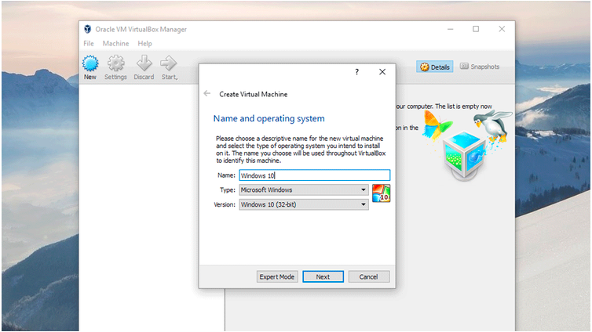

Slide 6
Type: linux
Version: Ubuntu 64bit
After selecting your operating system and the exact version you’ll need to allocate the Memory size that the VM will have access to.
VirtualBox will recommend an amount, and we suggest you go with that then click next.

Slide 7
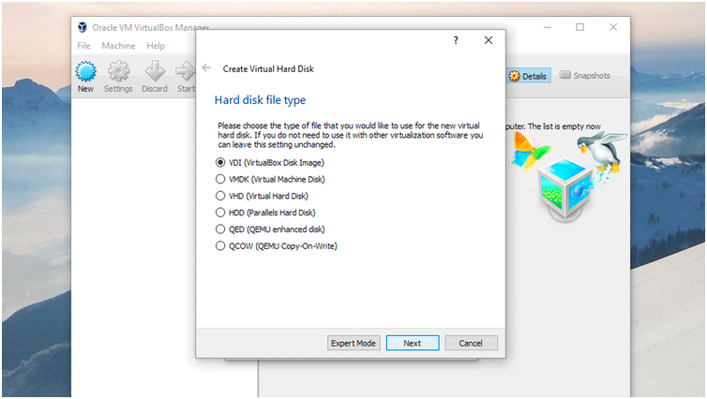

Slide 8
When the virtual drive has been created you can now begin installing your operating system.
To do this click the Start arrow. In the window that appears (Select start-up disk)
click on the folder to the right of the drop-down menu that appears next to 'Empty'.
Here you can navigate to the UbuntuISO file that you downloaded earlier.

Slide 9
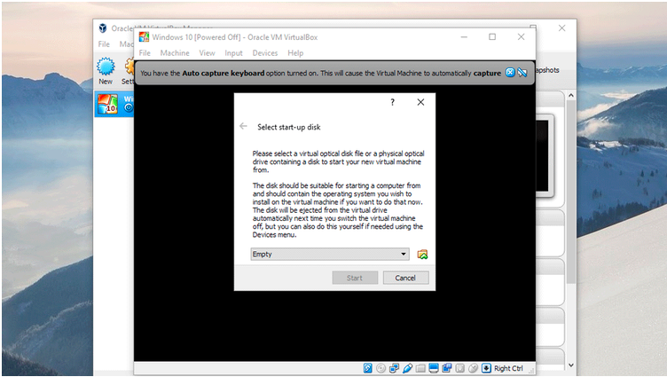

Slide 10
Once you’ve selected the ISO click Start and the OS will be installed on your virtual machine.
Once that's done, you can use your virtual operating system in a Window, just like any other app.
To shut it down, click the File menu and choose 'Close' and then 'Save the machine state'.

Slide 11
Install Ubuntu in VM
https://unixcop.com/how-to-install-ubuntu-21-04-on-vmware-workstation-pro/
Video Link:
https://www.youtube.com/watch?v=CrmHoSG8zSU

Slide 12
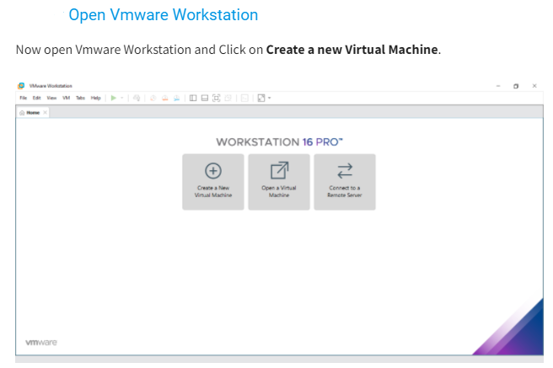

Slide 13
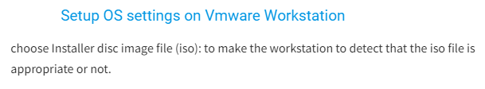
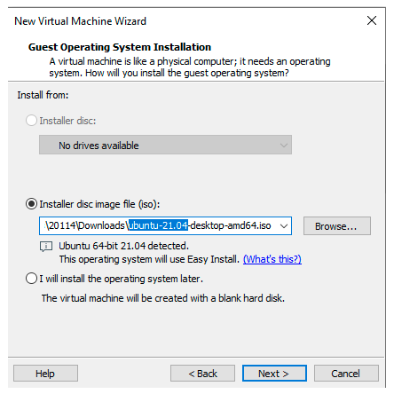

Slide 14
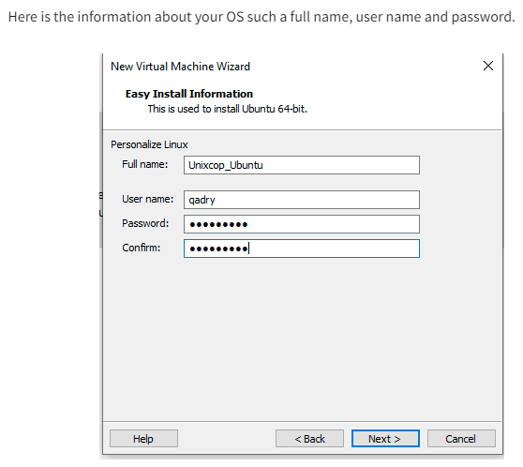

Slide 15
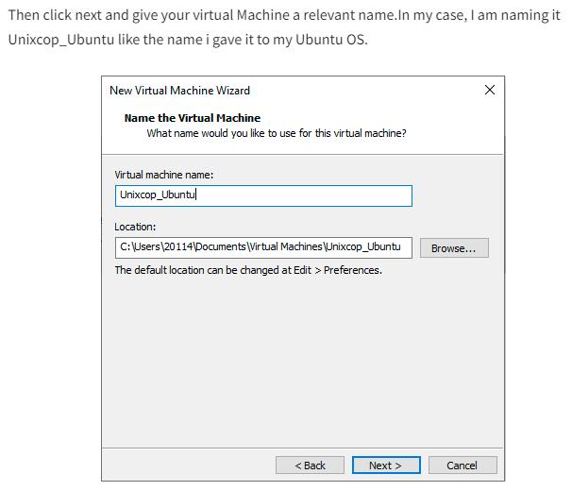

Slide 16
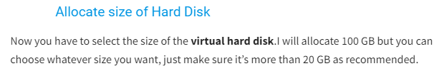
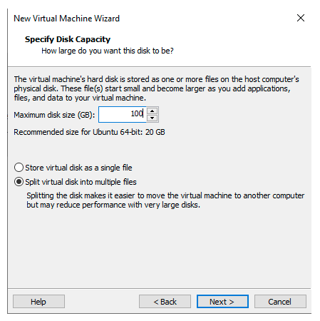

Slide 17
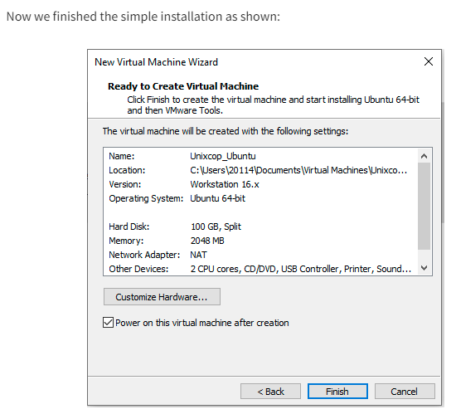

Slide 18

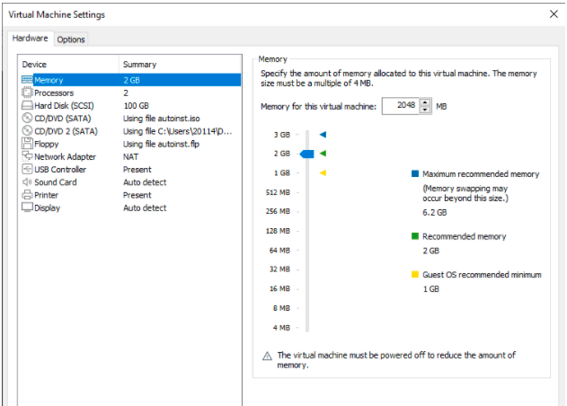
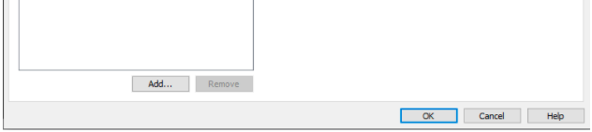

Slide 19
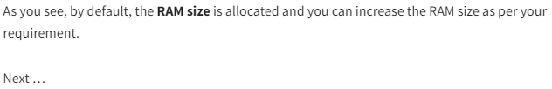
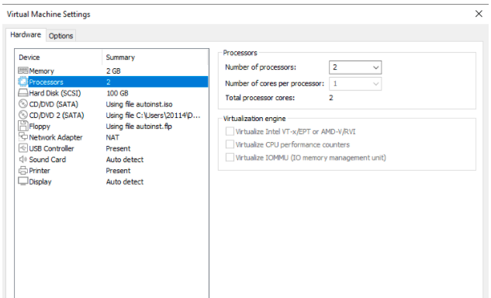
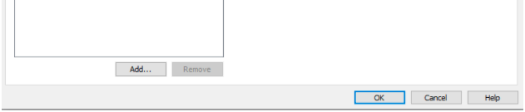

Slide 20
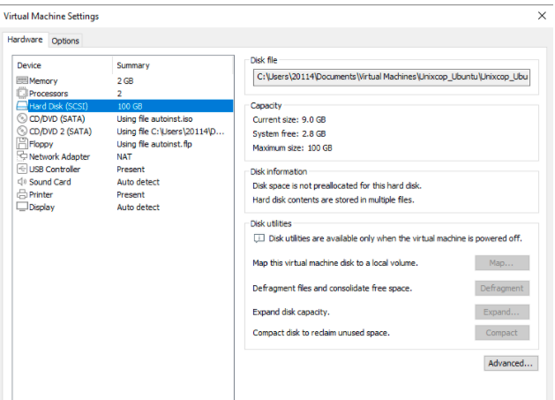

Slide 21
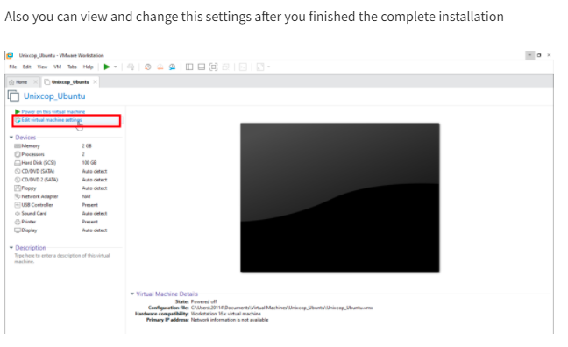

Slide 22
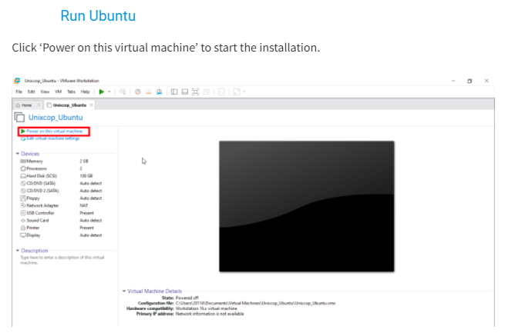

Slide 23
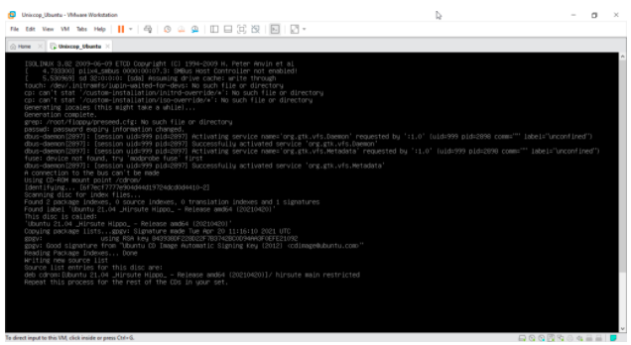

Slide 24
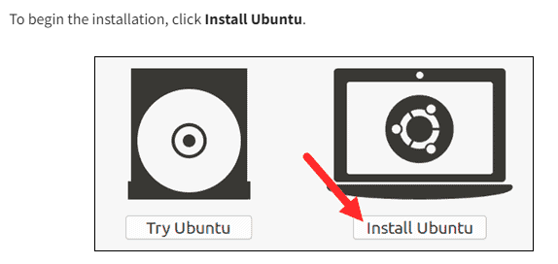
Install Ubuntu

Slide 25
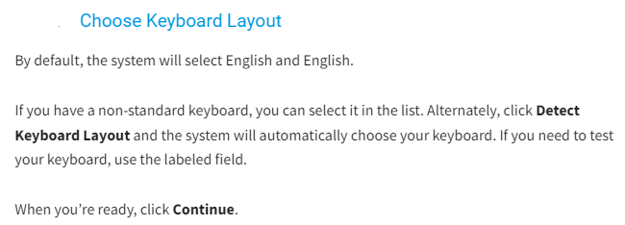
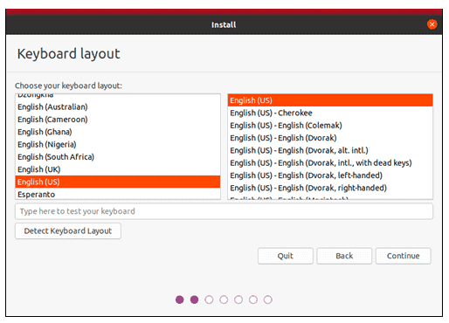

Slide 26
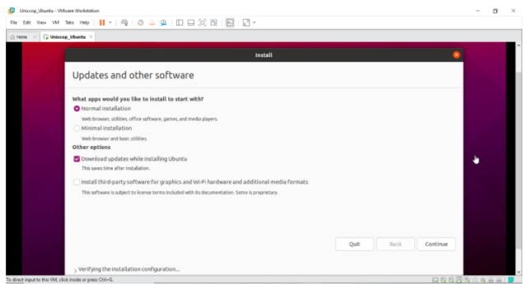

Slide 27
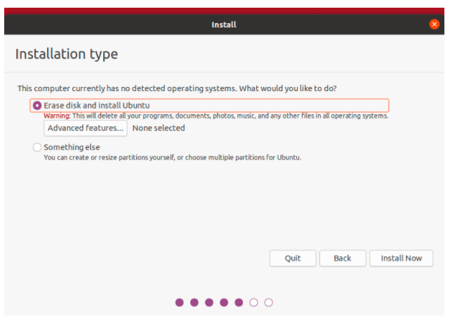
Choose installation type

Slide 28
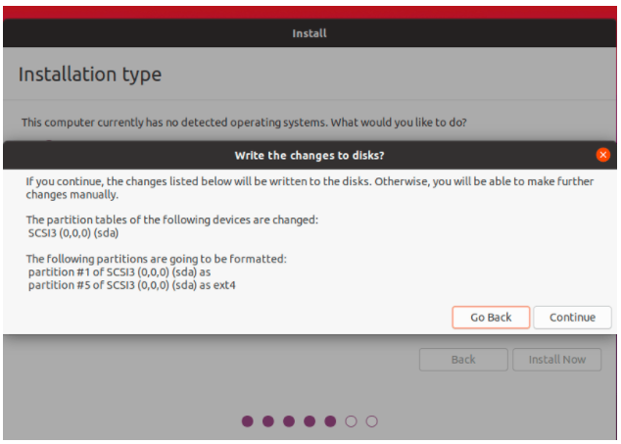

Slide 29
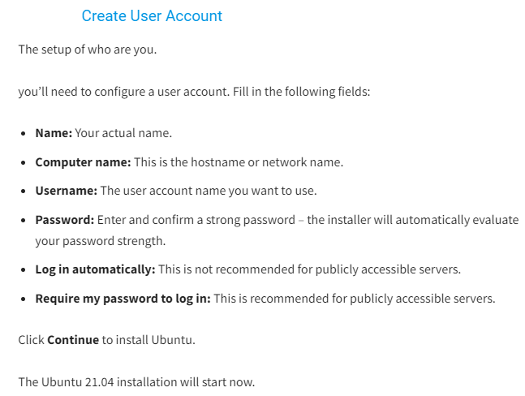

Slide 30
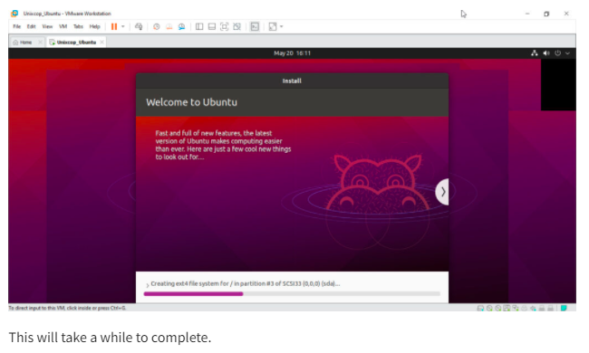

Slide 31
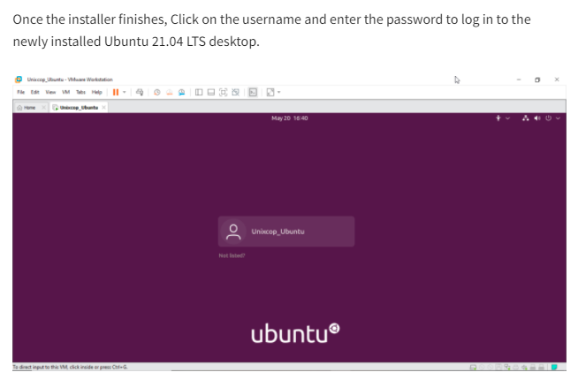

Slide 32
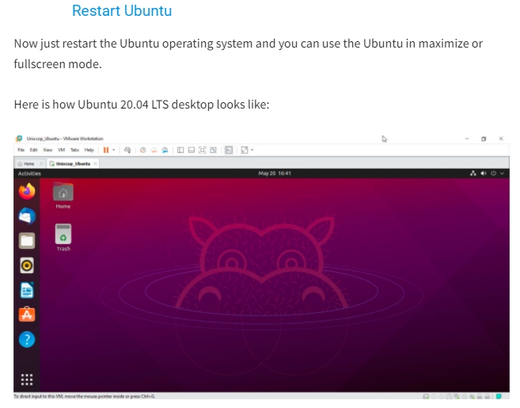

Slide 33
VM Error
Suppose if your virtual machine shows error.
To Enable/Disable, VM setting,
Reboot the system ( while reboot, press Esc )
Immediately press BIOS settings, F10 Button.
Under Security -> System Security
Virtual Machine Technology -> Enable
Again Press F10
File -> Save & Exit.
Then install Ubuntu iso-file in Virtual Box.

